Slide 1
Controlling Navigation
Module 8

Slide 2
Objectives
Demonstrate the ability to modify the Dynamics 365 UI by changing the sitemap, and affect the user’s interaction within forms and access to external resources by modifying the command bar
Edit the sitemap manually or with the XrmToolBox SiteMap editor to show or hide areas and links
Edit the command bar with a ribbon editor
Create new buttons on Form command bars
Create command Actions to navigate or run Jscript resources
Pass parameters to Web Resources and Forms to populate fields or supply business data

Slide 3
Sitemap modification
Manual modification
Include sitemap in solution.
Export solution.
Modify customizations.xml, overwrite file in solution zip.
Re-import modified solution.
Using the XrmToolBox Sitemap editor tool
Connect to Organization Service.
Load sitemap.
Use the designer to add/edit the sitemap.
Save changes.
Notes:
Note: It is recommended to create an empty solution to add the sitemap to, so that any import / export has no implications on any other Dynamics 365 entity.

Slide 4
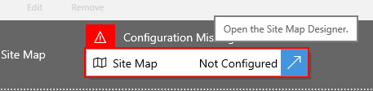
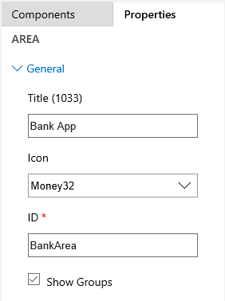
Sitemap modification
Use Site Map Designer
Dynamics 365 provides a graphical tool to edit the site map
Create Areas and Sub Areas with associated Entities , Webresources
Notes:
Note: It is recommended to create an empty solution to add the sitemap to, so that any import / export has no implications on any other Dynamics 365 entity.

Slide 5
SiteMap Structure
The SiteMap is held in an XML structure
Root node SiteMap has Area childnodes – each area maps to a major functional area in CRM, Sales, Services, etc.
Each Area divided contains Groups, minor functional subdivisions – such as Sales Area > MyWork, and Sales Area > Customers Group
Each Group subdivided into SubAreas equivalent to buttons on the SiteMap ribbon - Sales (Area) > Customers (Group) > Accounts (SubArea)
A SubArea can contain Titles and Descriptions for language specific labels
Notes:
In this diagram the sitemap editor shows the top level areas SFA (Sales), CS (Services), MA(Marketing), Settings (Settings), HLP (Help) on the LHS tree view. Across the top of the diagram the CRM UI shows the same areas as buttons on the sitemap
The Area Sales contains the Groups MyWork, Customers, Sales, Collateral, Marketing, Goals, Tools, Extensions.

Slide 6
Notes:
Extending the Sales Area reveals the Groups; MyWork, Customers, Sales, Collateral ,Marketing,Goals , Tools, Extensionsas can be seen in the UI with the titles above the buttons.
Extending the Group Customers reveals the SubAreas; Accounts and Contacts as can be seen by the 2 buttons under the Group Customers in the Sitemap
This is the XML for the SiteMap
This is the perspective from XrmToolBox SiteMap editor

Slide 7
Notes:
New buttons can be created in the sitemap by adding subarea elements with either an entity attribute to specify the entity to link to or a Url attribute to point to an external resource (Google) or an included webresource. The builder on the Url property allows the selection of web resources and sets the property in the format “$webresource:new_/subfolder/mypage.html”. However Javascripts web resources can not be directly referenced (indirectly through an html web resource)
<SubArea Id="nav_new_bank_account" Entity="new_bankaccount" >
<Titles>
<Title LCID="1033" Title="US Bank Account" />
</Titles>
<Descriptions>
<Description LCID="1033" Description="US Bank Account" />
</Descriptions>
</SubArea>
The Titles and Descriptions are containers for language specific Title and Description values.
Using the XrmToolbox sitemap editor, select Titles in treeview to add additional title elements. Other Language Codes (need to add language packs to CRM first – already available if running CRM online)
Settings >Administration>Languages
1031:de_DE, 1036:fr_FR, 1034:es_ES
If other language packs are added, can go into Options>Langauges>set to another language you have created a Title for and observe the Language specific Title on refresh.
A SiteMap button can be prevented from displaying to a non-privileged user
By adding a privilege to a SubArea, for example setting a Read privilege on
<SubArea Entity="new_bankaccount" Id="tempId_635639247698870543" AvailableOffline="false" PassParams="false">
<Privilege Entity="new_bankaccount" Privilege="Read" />
</SubArea>
Test this by logging onto CRM as anyone but the System Administrator, without the read permission on new_bankaccount, to see the button hidden

Slide 8
Ribbon/Command Bar
The Command Bar is the navigation bar displayed across the Form, child SubGrids or Grid
Each Form, child SubGrids or Grid, can have different buttons, that perform different Actions and are displayed or enabled based on the meeting of specific rules
The Ribbon navigation bar from earlier CRM versions is still present on many system forms, such as the form designer, and is characterised by the Tabs, rather than command groups
The Ribbon/Command Bar information can be exported for manipulation outside of CRM using the RibbonDiff of the Customizations.xml in a similar manner to modifying the SiteMap
The Ribbon/Command Bar can be modified by including existing Application Ribbon in a Dynamics 365 solution then modifying the RibbonDiff section of the exported Customizations.xml
Notes:
The Form design Navigation bar is an example of the earlier CRM Ribbon.
To Modify the Command Bar manually, in an existing CRM solution including the entity for which a Command Bar customisation is required, add existing item > ApplicationRibbon. Export the solution, and open the Customizations.xml with Visual Studio.
Notice the structure:
The RibbonDiffXml is the root of CustomActions, CommandDefinitions, RuleDefinitions and LocLabels. Each CommandAction defines a context from which to associate appropriate Display and Enable Rules, and to perform particular actions. The separation of the CommandDefinitions, Actions, and Rules from the CommandUIDefinition allows each CommandDefinition to reuse one or more enable or display Rules, and each CommandDefinition to be reused by one or more CommandUIDefinitions.

Slide 9
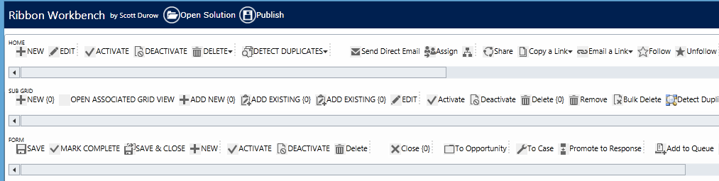
Using a ribbon editor
The above is an example of a ribbon editor for the grade entity with Home, SubGrid and Form rows
The top row, Home, shows the ribbon for viewing multiple grids
The bottom row, Form, shows the ribbon for a single record instance
The middle row, Subgrid, is displayed when a view of child entities is seen from the parent
Notes:
The SubGrid ribbon seen from Student Form view perspective
The Home row is seen when viewing the resultset of grades

Slide 10
Modifying the Ribbon
Add button – set id, label text, image
Each button can associate with a command
Each command can link with actions – run web resource script, or navigate to Url
Each command can be conditionally displayed or enabled based on DisplayRules and EnableRules
Each DisplayRule and EnableRule can test for conditions based on field values, security permissions, form mode, Crm Client mode etc.
Notes:
Setting the properties of a new button in a ribbon editor
Buttons are related to Commands. First Right Click the Commands section > new Command.
For both Action types, Open URL, and JavaScript Function, parameters can be passed, these need to be added with the Parameters dialog

Slide 11
Module 8 Lab A
Creating a Site Map

Slide 12
Module 8 Lab B Lab 9.3
Using Ribbon WorkBench

